Slide 1
Cornerstone City Church Peninsula Plus Community Hoo Are Ya
28th July 2024

Slide 2
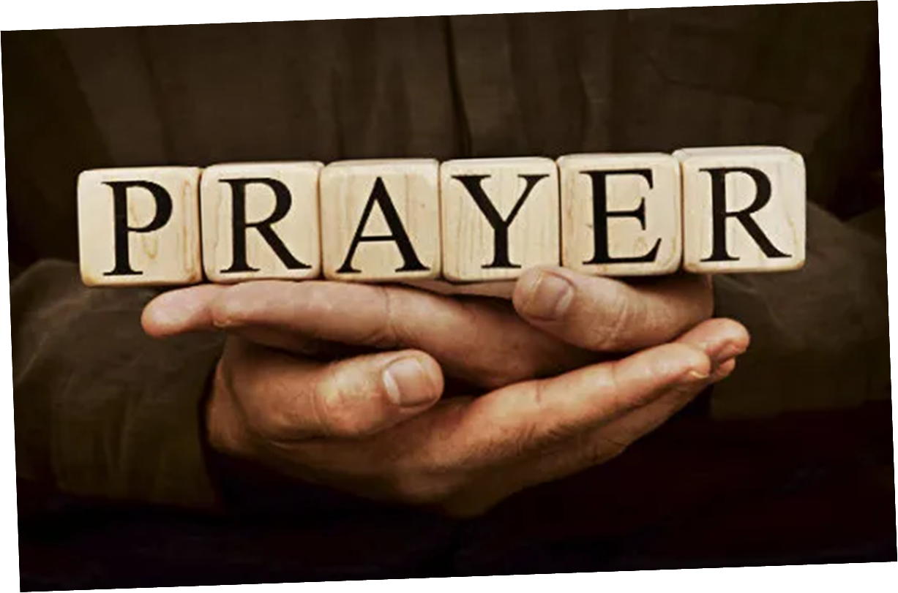

Slide 3


Slide 4
This Is Amazing Grace
CCLI Song # 6333821
Jeremy Riddle | Josh Farro | Phil Wickham
© 2012 WC Music Corp. (Admin. by / Small Stone Media BV, Holland (Admin. in the UK/Eire by Song Solutions www.songsolutions.org))
Bethel Music Publishing (Admin. by Song Solutions)
Phil Wickham Music (Admin. by Song Solutions www.songsolutions.org)
Seems Like Music (Admin. by Song Solutions www.songsolutions.org)
Sing My Songs (Admin. by Song Solutions www.songsolutions.org)
For use solely with the SongSelect® Terms of Use. All rights reserved. www.ccli.com
CCLI Licence No. 33265

Slide 5
1/7
Who breaks the power of sin and darkness
Whose love is mighty and so much stronger
The King of Glory the King above all kings

Slide 6
2/7
Who shakes the whole earth with holy thunder
And leaves us breathless in awe and wonder
The King of Glory the King above all kings

Slide 7
3/7
This is amazing grace
This is unfailing love
That You would take my place
That You would bear my cross
You laid down Your life
That I would be set free
Oh Jesus I sing for all that You've done for me

Slide 8
4/7
Who brings our chaos back into order
Who makes the orphan a son and daughter
The King of Glory the King of Glory

Slide 9
5/7
Who rules the nations with truth and justice
Shines like the sun in all of its brilliance
The King of Glory the King above all kings

Slide 10
6/7
This is amazing grace
This is unfailing love
That You would take my place
That You would bear my cross
You laid down Your life
That I would be set free
Oh Jesus I sing for all that You've done for me

Slide 11
7/7
Worthy is the Lamb who was slain
Worthy is the King who conquered the grave
Worthy is the Lamb who was slain
Worthy is the King who conquered the grave
Worthy is the Lamb who was slain
Worthy is the King who conquered the grave
Worthy is the Lamb who was slain
Worthy worthy worthy

Slide 12
Evidence
CCLI Song # 7147432
Ed Cash | Ethan Hulse | Josh Baldwin
© 2020 Capitol CMG Paragon; We The Kingdom Music; Be Essential Songs; EGH Music Publishing; Bethel Music Publishing
For use solely with the SongSelect® Terms of Use. All rights reserved. www.ccli.com
CCLI Licence No. 33265

Slide 13
1/7
All throughout my history
Your faithfulness has walked beside me
The winter storms made way for spring
In every season from where I'm standing

Slide 14
2/7
I see the evidence of Your goodness
All over my life
All over my life
I see Your promises in fulfillment
All over my life
All over my life

Slide 15
3/7
Help me remember when I'm weak
Fear may come but fear will leave
You lead my heart to victory
You are my strength and You always will be

Slide 16
4/7
I see the evidence of Your goodness
All over my life
All over my life
I see Your promises in fulfillment
All over my life
All over my life

Slide 17
5/7
See the cross the empty grave
The evidence is endless
All my sin rolled away
Because of You oh Jesus

Slide 18
6/7
I see the evidence of Your goodness
All over my life
All over my life
I see Your promises in fulfillment
All over my life
All over my life

Slide 19
7/7
Why should I fear
(Oh) The evidence is here

Slide 21
Good Good Father
CCLI Song # 7036612
Anthony Brown | Pat Barrett
© 2014 Capitol CMG Paragon (Admin. by Capitol CMG Publishing)
Common Hymnal Digital (Admin. by Capitol CMG Publishing)
Housefires Sounds (Admin. by Capitol CMG Publishing)
Rising Springs Music (Admin. by Capitol CMG Publishing)
Tony Brown Publishing Designee (Admin. by Capitol CMG Publishing)
Vamos Publishing (Admin. by Capitol CMG Publishing)
worshiptogether.com songs (Admin. by Capitol CMG Publishing)
For use solely with the SongSelect® Terms of Use. All rights reserved. www.ccli.com
CCLI Licence No. 33265

Slide 22
1/7
I've heard a thousand stories
Of what they think You’re like
But I've heard the tender whisper
Of love in the dead of night
You tell me that You’re pleased
And that I'm never alone

Slide 23
2/7
You're a Good Good Father
It's who You are
It's who You are
It's who You are
And I'm loved by You
It's who I am
It's who I am
It's who I am

Slide 24
3/7
I've seen many searching for answers
Far and wide
But I know we're all searching for answers
Only You provide
Because You know just what we need
Before we say a word

Slide 25
4/7
You're a Good Good Father
It's who You are
It's who You are
It's who You are
And I'm loved by You
It's who I am
It's who I am
It's who I am

Slide 26
5/7
You are perfect in all of Your ways
You are perfect in all of Your ways
You are perfect in all of Your ways to us

Slide 27
6/7
Love so undeniable I can hardly speak
Peace so unexplainable I can hardly think
As You call me deeper still
As You call me deeper still
As You call me deeper still
Into love love love

Slide 28
7/7
You're a Good Good Father
It's who You are
It's who You are
It's who You are
And I'm loved by You
It's who I am
It's who I am
It's who I am

Slide 30
O Come To The Altar
CCLI Song # 7051511
Chris Brown | Mack Brock | Steven Furtick | Wade Joye
© 2015 Music by Elevation Worship Publishing
For use solely with the SongSelect® Terms of Use. All rights reserved. www.ccli.com
CCLI Licence No. 33265

Slide 31
1/7
Are you hurting and broken within
Overwhelmed by the weight of your sin
Jesus is calling
Have you come to the end of yourself
Do you thirst for a drink from the well
Jesus is calling

Slide 32
2/7
O come to the altar
The Father's arms are open wide
Forgiveness was bought with
The precious blood of Jesus Christ

Slide 33
3/7
Leave behind your regrets and mistakes
Come today there's no reason to wait
Jesus is calling
Bring your sorrows and trade them for joy
From the ashes a new life is born
Jesus is calling

Slide 34
4/7
O come to the altar
The Father's arms are open wide
Forgiveness was bought with
The precious blood of Jesus Christ (REPEAT)

Slide 35
5/7
Oh what a Savior
Isn't he wonderful
Sing alleluia Christ is risen
Bow down before him
For he is Lord of all
Sing alleluia Christ is risen

Slide 36
6/7
O come to the altar
The Father's arms are open wide
Forgiveness was bought with
The precious blood of Jesus Christ

Slide 37
7/7
Bear your cross as you wait for the crown
Tell the world of the treasure you've found

Slide 38
More Like Jesus
CCLI Song # 7105732
Brett Younker | Brooke Ligertwood | Kristian Stanfill | Scott Ligertwood
© sixsteps Music; worshiptogether.com songs; SHOUT! Music Publishing Australia
For use solely with the SongSelect® Terms of Use. All rights reserved. www.ccli.com
CCLI Licence No. 33265

Slide 39
1/7
You came to the world You created
Trading Your crown for a cross
You willingly died
Your innocent life paid the cost

Slide 40
2/7
Counting Your status as nothing
The King of all kings came to serve
Washing my feet
Covering me with Your love

Slide 41
3/7
If more of You means less of me
Take ev'rything
Yes all of You is all I need
Take ev'rything

Slide 42
4/7
You are my life and my treasure
The One that I can't live without
Here at Your feet
My desires and dreams I lay down
Here at Your feet
My desires and dreams I lay down

Slide 43
5/7
If more of You means less of me
Take ev'rything
Yes all of You is all I need
Take ev'rything

Slide 44
6/7
Oh Lord change me like only You can
Here with my heart in Your hands
Father I pray make me more like Jesus
This world is dying to know who You are
You've shown us the way to Your heart
So Father I pray make me more like Jesus
(More like Jesus more like Jesus Lord)

Slide 45
7/7
If more of You means less of me
Take ev'rything
Yes all of You is all I need
Take ev'rything

Slide 46
1/1
Lord I give You my heart
I give You my soul
I live for You alone
Ev'ry breath that I take
Ev'ry moment I'm awake
Lord have Your way in me

Slide 47


Slide 48
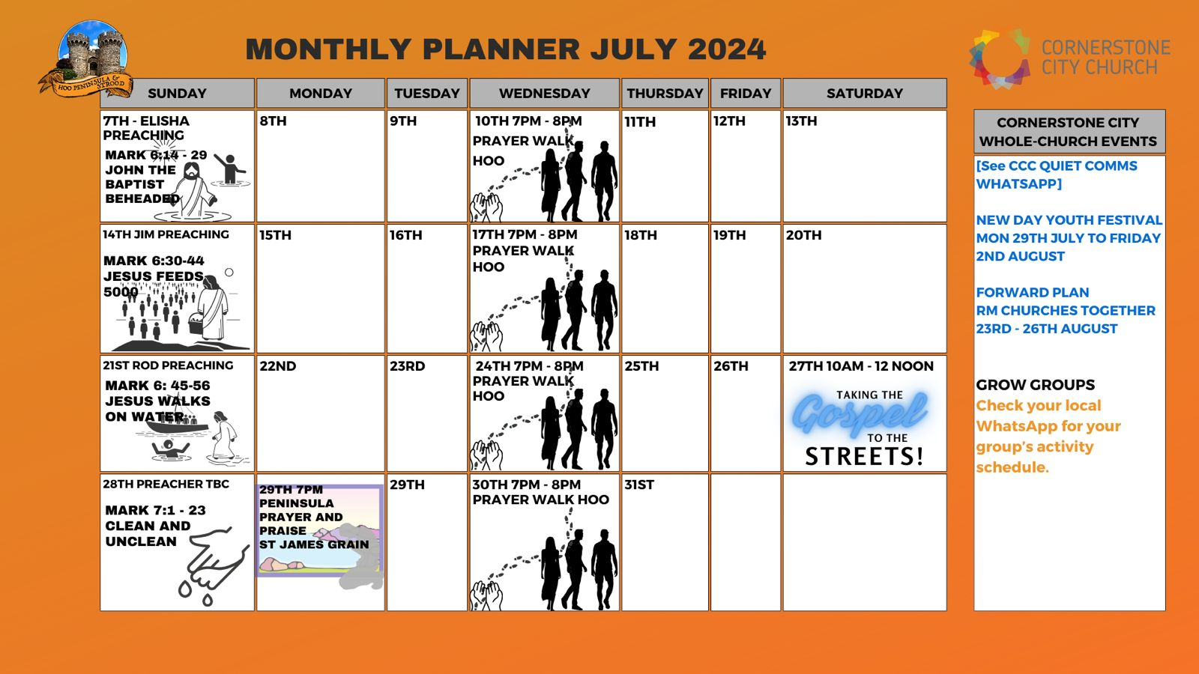

Slide 49


Slide 50


Slide 51
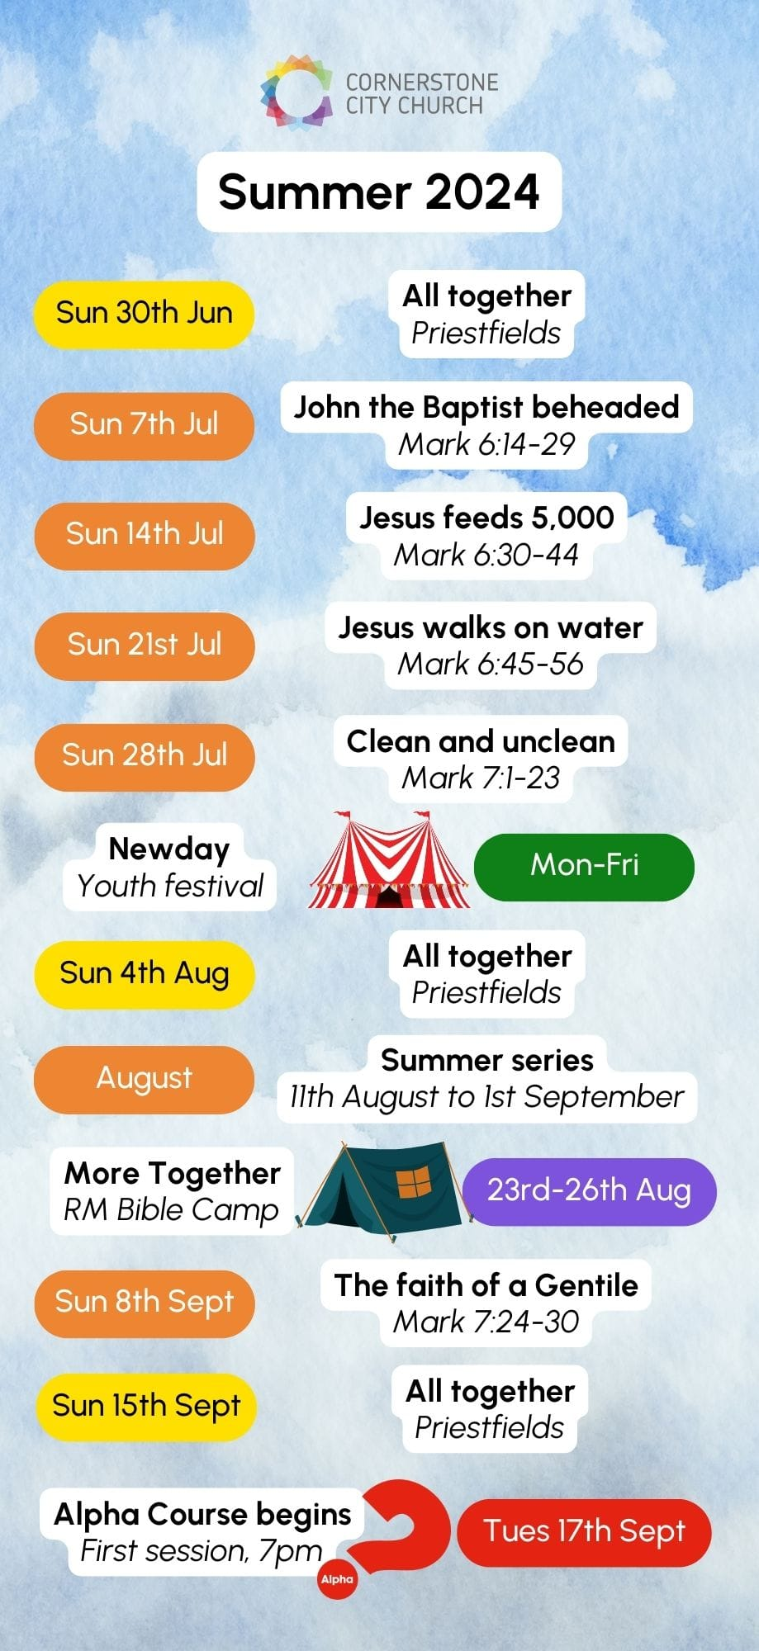

Slide 52


Slide 53


Slide 54
Goodness Of God
CCLI Song # 7117726
Ben Fielding | Brian Johnson | Ed Cash | Jason Ingram | Jenn Johnson
© 2018 Capitol CMG Paragon (Admin. by Capitol CMG Publishing)
Fellow Ships Music (Admin. by Essential Music Publishing LLC)
So Essential Tunes (Admin. by Essential Music Publishing LLC)
SHOUT! Music Publishing Australia (Admin. by SHOUT! Music Publishing UK)
Bethel Music Publishing (Admin. by Song Solutions)
For use solely with the SongSelect® Terms of Use. All rights reserved. www.ccli.com
CCLI Licence No. 33265

Slide 55
1/4
I love You Lord
Oh Your mercy never fails me
All my days
I've been held in Your hands
From the moment that I wake up
Until I lay my head
I will sing of the goodness of God

Slide 56
2/4
All my life You have been faithful
All my life You have been so so good
With every breath that I am able
I will sing of the goodness of God

Slide 57
3/4
I love Your voice
You have led me through the fire
In darkest night
You are close like no other
I've known You as a father
I've known You as a friend
I have lived in the goodness of God

Slide 58
4/4
Your goodness is running after
It’s running after me
(REPEAT)
With my life laid down
I’m surrendered now
I give You everything
Your goodness is running after
It's running after me

Slide 59
2 Corinthians 14 May the grace of the Lord Jesus Christ, and the love of God, and the fellowship of the Holy Spirit be with you all

